Slide 1
12/5/22

Slide 2
6.4: Array Algorithms
part 2

Slide 3
Common Array Algorithms (bold ones today)
Here are some common algorithms that you should be familiar with for the AP CS A exam:
Determine the minimum or maximum value in an array
Compute a sum, average, or mode of array elements
Search for a particular element in the array
Determine if at least one element has a particular property
Determine if all elements have a particular property
Access all consecutive pairs of elements
Determine the presence or absence of duplicate elements
Determine the number of elements meeting specific criteria
Shift or rotate elements left or right
Reverse the order of the elements
Hmm, we didn't get very far on Friday... going to have to have an efficient algorithm today to cover all these...

Slide 4
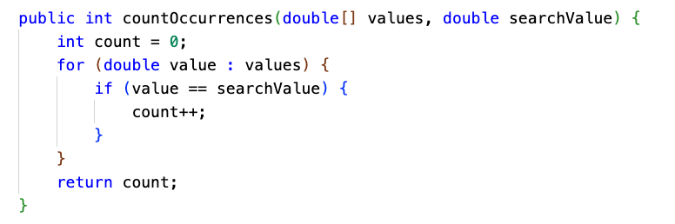
Determine number of elements meeting specific criteria

Slide 5
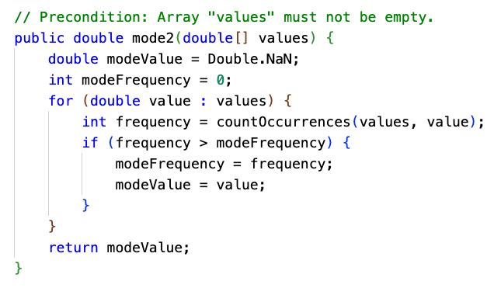
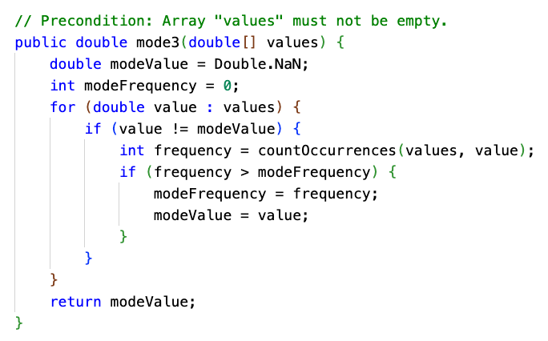
Mode of unsorted array, using helper method

Slide 6
Mode of unsorted array, using helper method
0 | 1 | 2 | 3 | 4 | 5 | 6 | 7 | 8 | 9 | 10 | 11
17 | 17 | 9 | 9 | 9 | 9 | 1 | 17 | 19 | 3 | 3 | 5
countOccurrences(values, values[i])
3 | skip | 4 | skip | skip | skip | 1 | 3 | 1 | 2 | skip | 1
modeValue
17 |  | 9
modeFrequency
3 |  | 4

Slide 7
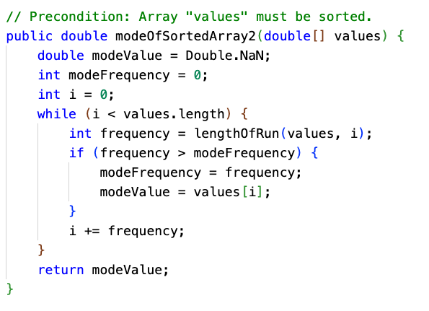
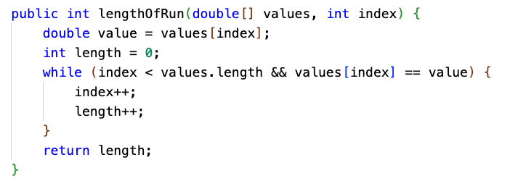
Mode of sorted array, with helper method
1 | 1 | 2 | 2 | 2 | 3 | 3 | 3 | 3 | 4 | 4 | 5

Slide 8
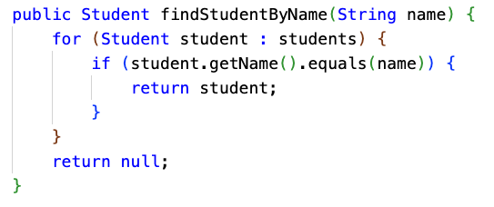
Search for a particular element in the array
This is known as linear search, the simplest (and least efficient) of search algorithms. We'll learn others later.

Slide 9
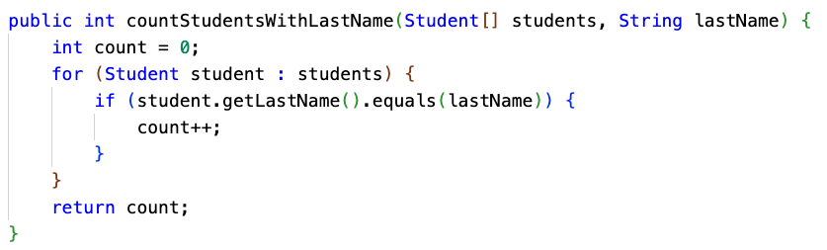
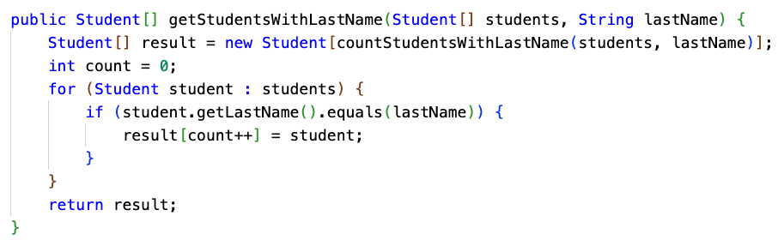
Filter an array for all matching elements
What if you want to find all matching elements? One way is to filter the array into a new array.
When returning an array that is a subset of the original array, you have to decide how big to make the result array.
Here, we do it by doing another pass through the array just to count how big the result array should be, using a helper method.
Another option would be the "growable array" pattern... In Unit 7, we'll cover ArrayList which could be used for this purpose.

Slide 10
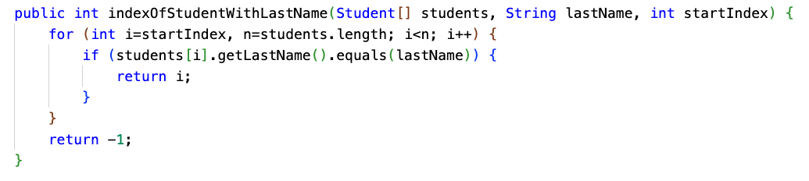
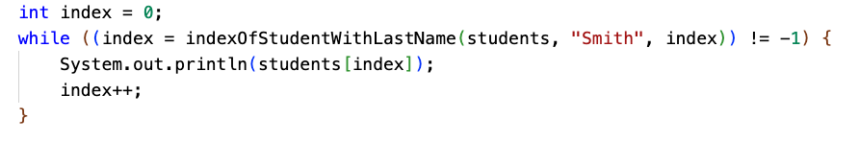
Search for all matching elements
Another way to find all matching elements is to build your own indexOf with startIndex parameter.

Slide 11
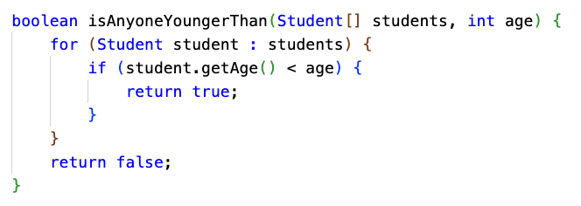
Determine if at least one element has a particular property
The output of this type of algorithm is a boolean. As soon as you find the first element with the desired property, you can return true.

Slide 12
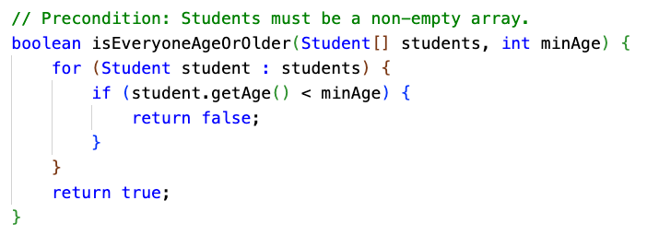
Determine if all elements have a particular property
This is essentially the same, except we're trying to ensure that ALL elements have some property. As soon as we find an element that doesn't, we return false.

Slide 13
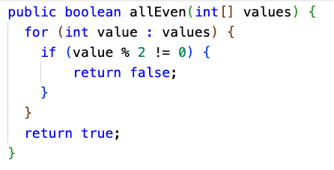
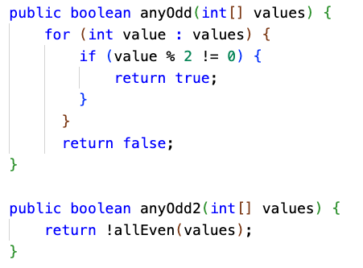
Universal / Existential Quantifiers
If all of the numbers all even, then there are no odd numbers.
If there are any odd numbers, then not all of the numbers are even.

Slide 14
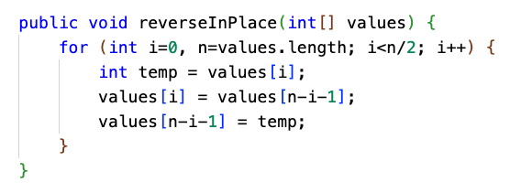
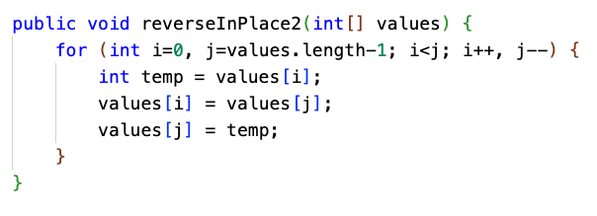
Reverse an array (in place)
The top implementation is fine, but the bottom one uses i and j instead of just i.
I find it easier to reason about what this algorithm is doing by having two index counters, "racing" toward each other from each end of the array.
Computers have many registers for storage of frequently used variables, so there is really no additional cost to having two variables instead of one. It can be even faster, since less arithmetic is performed.

Slide 15
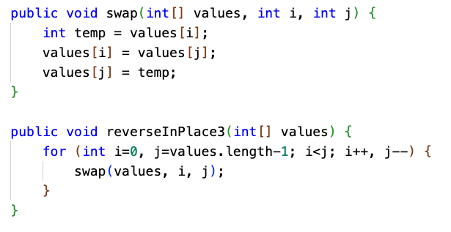
Reverse an array (in place)
A helper method to swap array elements makes the code even easier to understand.

Slide 16
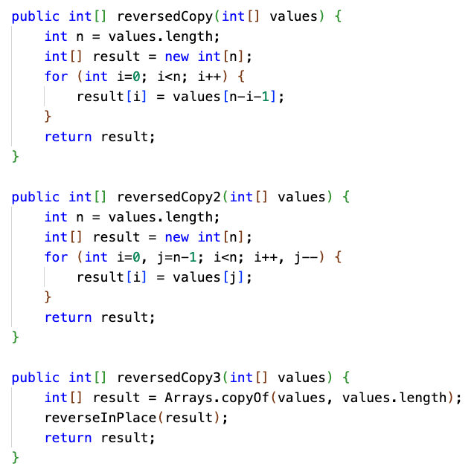
Return a reversed copy of an array
If you're returning a copy of an array in reverse order, you don't have to do any swapping.
It could still be helpful to use two counters instead of one.
You also could just not write the code at all... and leverage the reverse-in-place algorithm we just wrote. It will take a little more CPU time, though, since the array will first be copied, then reversed.

Slide 17
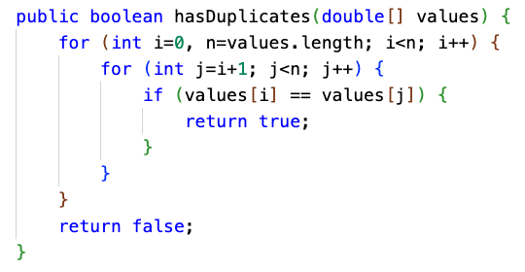
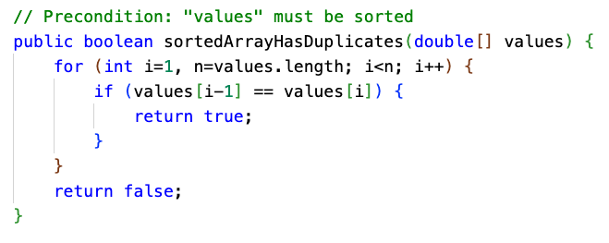
Check for presence of duplicate elements

Slide 18
Shift or rotate an array
Here, we rotate an array of numbers to the left by 1 position.
a[i] = a[i+1] for all i. The first element gets moved to the last position.
0 | 1 | 2 | 3 | 4 | 5 | 6 | 7 | 8 | 9 | 10 | 11
1 | 2 | 3 | 4 | 5 | 6 | 7 | 8 | 9 | 10 | 11 | 12
0 | 1 | 2 | 3 | 4 | 5 | 6 | 7 | 8 | 9 | 10 | 11
2 | 3 | 4 | 5 | 6 | 7 | 8 | 9 | 10 | 11 | 12 | 1

Slide 19
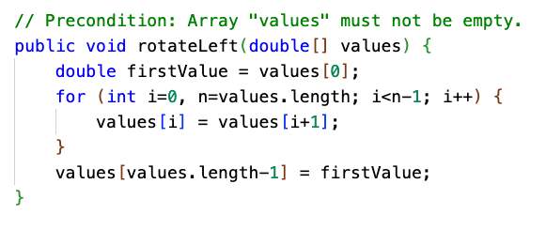
Rotate array to the left, in place
0 | 1 | 2 | 3 | 4 | 5 | 6 | 7 | 8 | 9 | 10 | 11
1 | 2 | 3 | 4 | 5 | 6 | 7 | 8 | 9 | 10 | 11 | 12
0 | 1 | 2 | 3 | 4 | 5 | 6 | 7 | 8 | 9 | 10 | 11
2 | 3 | 4 | 5 | 6 | 7 | 8 | 9 | 10 | 11 | 12 | 1

Slide 20
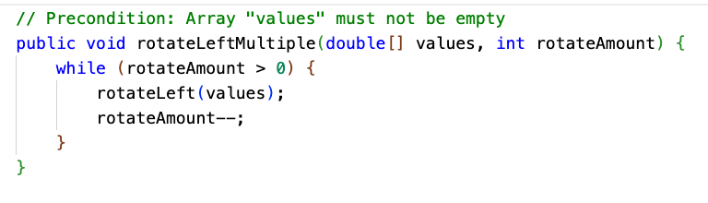
Rotate array to the left multiple positions, in place
There are other ways... but this is a quick and dirty way to do it.

Slide 21
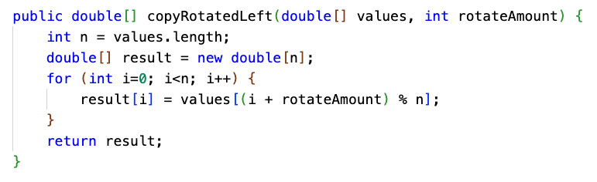
Rotate array to the left multiple positions, returning copy
Here's another instance where the % operator is very useful.

Slide 22
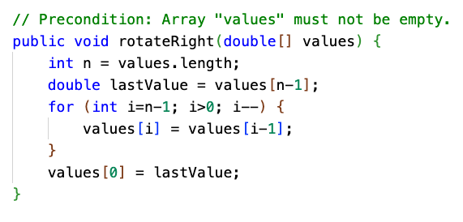
Rotate array to the right, in place
0 | 1 | 2 | 3 | 4 | 5 | 6 | 7 | 8 | 9 | 10 | 11
1 | 2 | 3 | 4 | 5 | 6 | 7 | 8 | 9 | 10 | 11 | 12
0 | 1 | 2 | 3 | 4 | 5 | 6 | 7 | 8 | 9 | 10 | 11
12 | 1 | 2 | 3 | 4 | 5 | 6 | 7 | 8 | 9 | 10 | 11

Slide 23
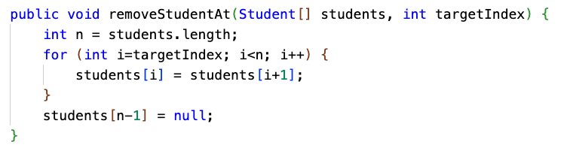
Remove element at specific index from an array
This is essentially like rotating left, but starting at a particular spot. Here, we fill in the end with null.

Slide 24
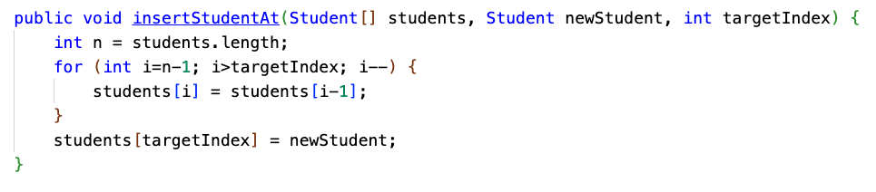
Insert element at specific index in array
This is very similar to rotating the array right, but starting at a specific index and not "wrapping."
The last element will be lost, so you'd have to make sure there is empty space at the end!

Slide 25
Practice!
Repl.it SieveOfEratosthenes
Repl.it ArrayAlgorithms is just the code in this slide deck, for your perusal.
CSAwesome 6.4 has several array algorithm Free Response Questions (FRQ) from real AP exams.
These FRQs build on the basic algorithms we just learned... but will usually have some practical application, may require more than one technique, and may have some curveball to them.
All are worth doing!

